Slide 1
New TKIs: What to watch?
Gregory Riely

Slide 2
Agenda
      Synthetic Lethal approaches
      SMARCA4 alterations
  MTAP deletions
  TP53 targeting

Slide 3
A bit of a pedantic tangent…

Slide 4
TKIs

Slide 5
Tyrosine
Kinase
Inhibitors

Slide 6
Tyrosine Kinase Inhibitors
Gefitinib
Erlotinib
Osimertinib
Alectinib
Lorlatinib
Crizotinib
Brigatinib
Capmatinib
Tepotinib
Repotrectinib
Entrectinib
Inhibit the EGF receptor tyrosine kinase
Inhibit the ALK receptor tyrosine kinase
Inhibit the MET receptor tyrosine kinase
Inhibit the ROS1 receptor tyrosine kinase

Slide 7
NOT Tyrosine kinase inhibitors
Encorafenib
Dabrafenib
Binimetinib
Trametinib
Adagrasib
Sotorasib
Inhibit the BRAF serine/threonine kinase
Inhibit the MEK serine/threonine kinase
Inhibit KRAS G12C (a GTPase) activity by binding GDP-KRAS G12C and trapping in an inactive state

Slide 8
NOT Tyrosine kinase inhibitors
Encorafenib
Dabrafenib
Binimetinib
Trametinib
Adagrasib
Sotorasib
Inhibit the BRAF serine/threonine kinase
Inhibit the MEK serine/threonine kinase
Inhibit KRAS G12C (a GTPase) activity by binding GDP-KRAS G12C and trapping in an inactive state
Also NOT a TKI? Everything else I will talk about in this session

Slide 9
Concept of “synthetic lethal”

Slide 10

Concept of “synthetic lethal”
Relax, the Terminator Is Far Away, NY Times 2015

Slide 11
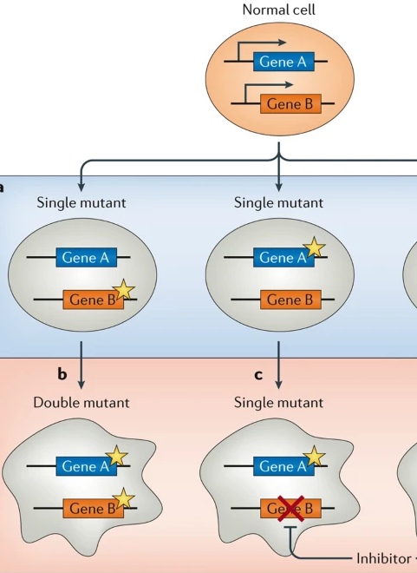
Concept of “synthetic lethal”
If two genes are required for normal cell function…
and
one of them is mutated/deleted in a cancer …
inhibiting the other one can preferentially kill mutated (cancer) cells
Viable
Lethal
Modified from O’Neil et al, Nature Rev Genetics 2017

Slide 12
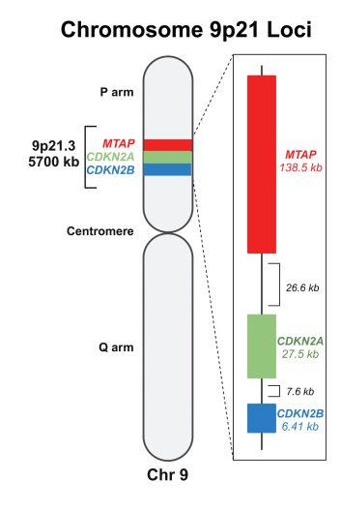
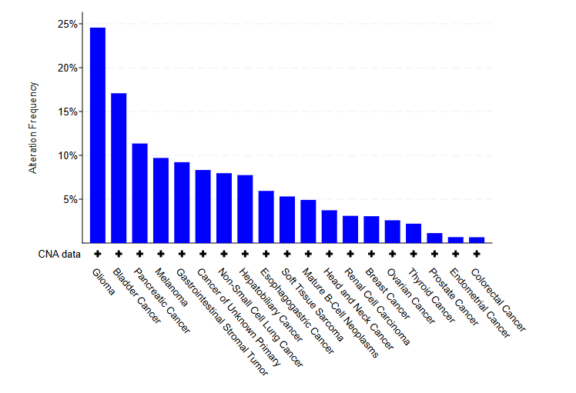
Targeting MTAP
CDKN2A encodes the tumor suppressors p16 and p14^{ARF} and is the most common homozygously deleted gene in all human cancers
MTAP is frequently lost due to its proximity to CDKN2A
Many platforms fail to test for MTAP deletion
Occurs in ~8% of NSCLC
Ngoi et al, Oncologist 2024; data from genie.cbioportal.org

Slide 13
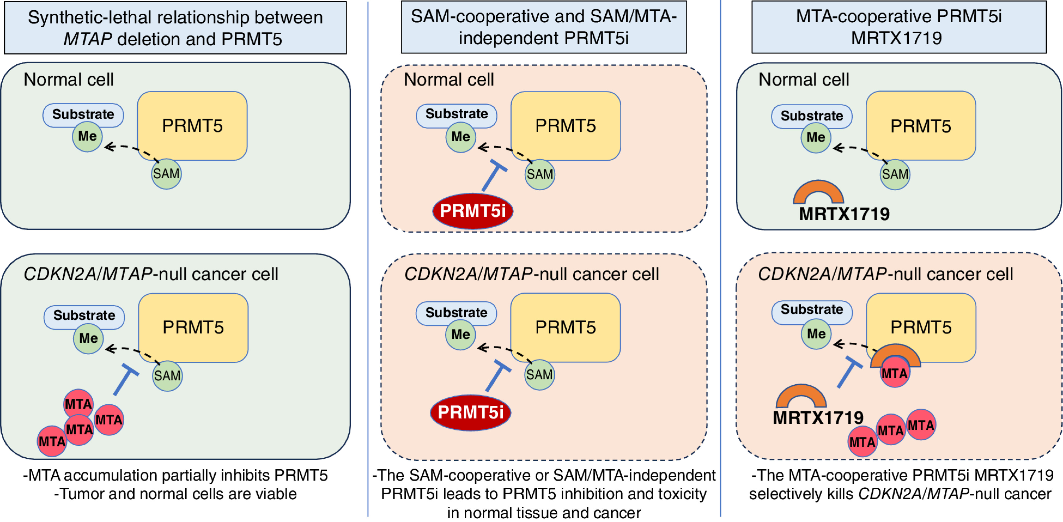
Synthetic lethality in action…
Mulvaney et al, Cancer Discovery 2023

Slide 14
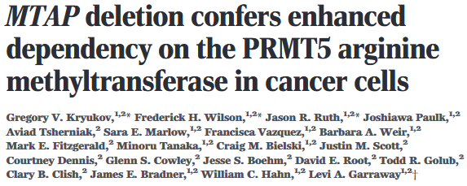
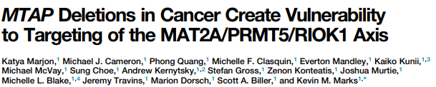
Cell Reports 2016
Science 2016

Slide 15
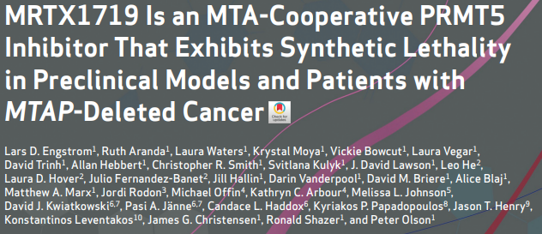
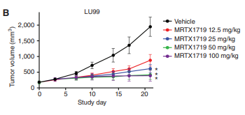
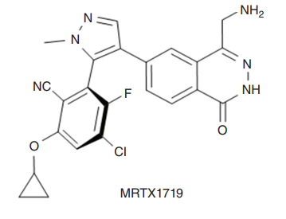
Engstrom et al, Cancer Discovery 2023

Slide 16
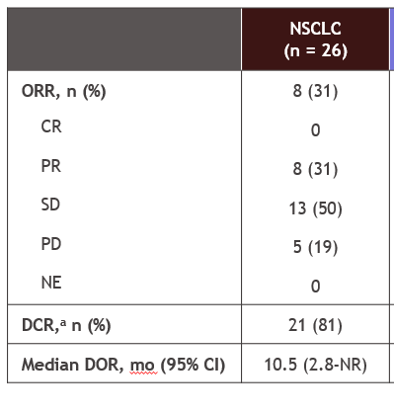
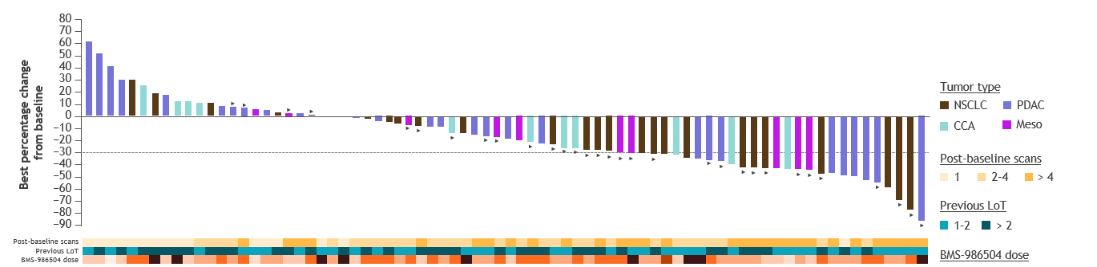
PRMT5 inhibitor BMS-986504 (MRTX1719) in pan-tumor phase 1
Rodon et al, ENA 2024

Slide 17
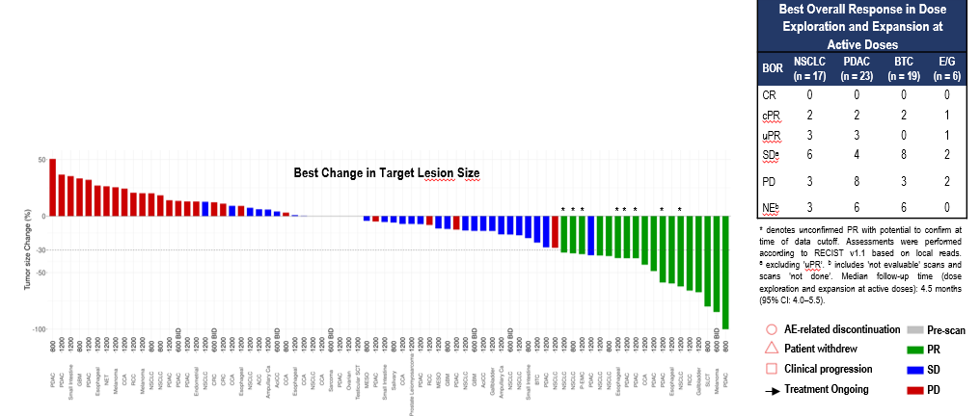
PRMT5 inhibitor AMG193 in pan-tumor phase 1
Sacher et al, ESMO 2024

Slide 18
Summary: Targeting MTAP deletion
MTAP often co-deleted with CDKN2A
Treating patients with MTAP deleted tumors with PRMT5 inhibitors leads to response rates of ~30%
Further refinement of biomarkers (NGS panels, IHC, etc) and further prospective trials will help to define whether this is targetable

Slide 19
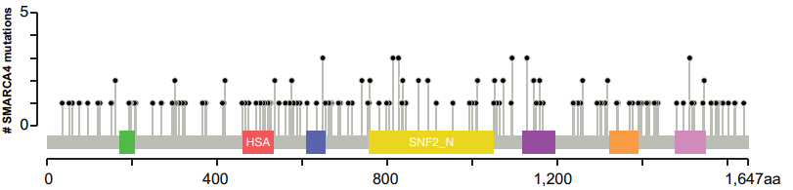
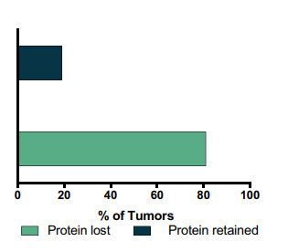
Targeting SMARCA4 alterations
Numerous point mutations lead to loss of functional protein
8% of patients with NSCLC have SMARCA4 mutations
Schoenfeld et al, CCR 2020

Slide 20
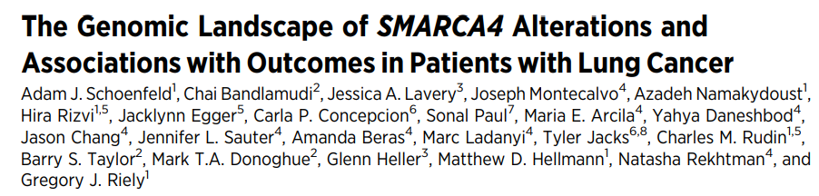
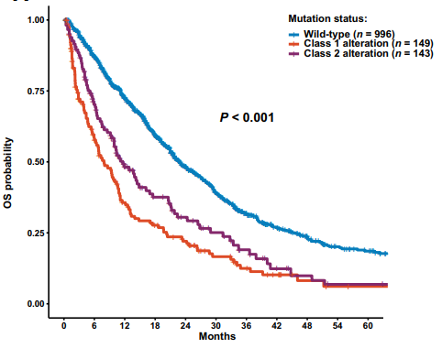
In patients with metastatic NSCLC, SMARCA4 alterations were associated with shorter overall survival

Slide 21
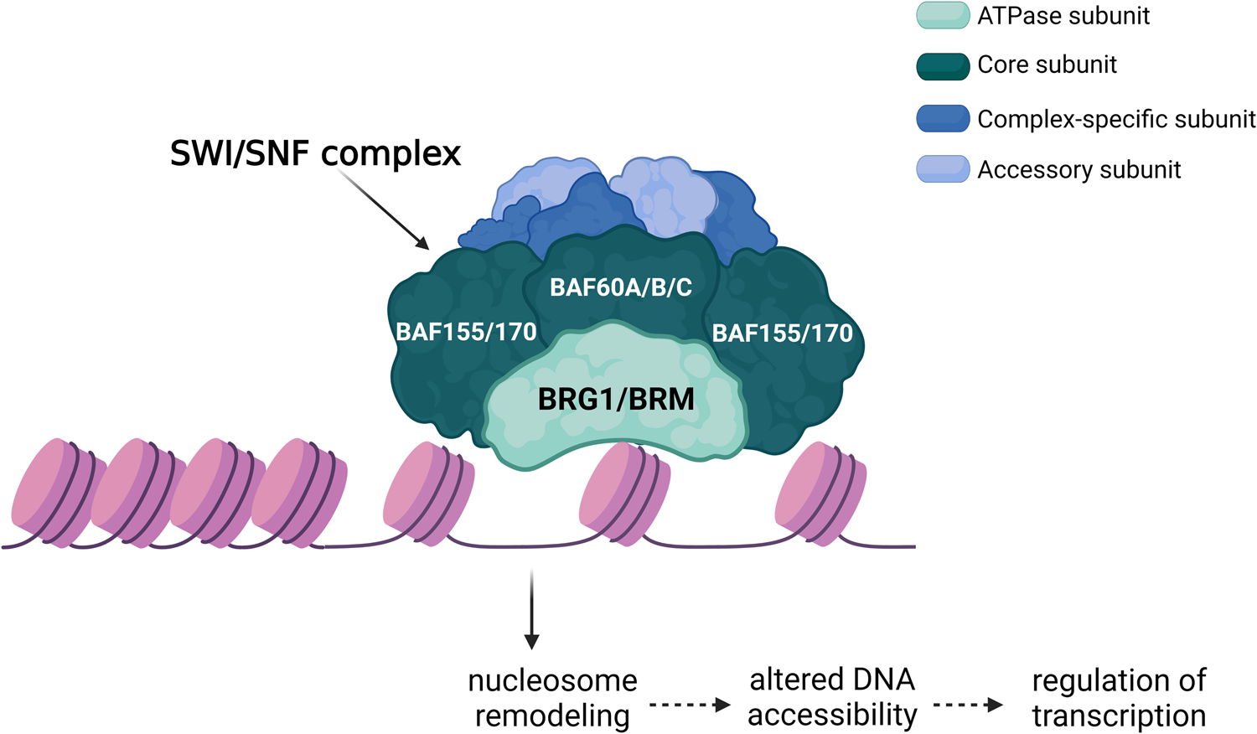
Targeting SMARCA4 alterations
SMARCA4 (BRG1)
or
SMARCA2 (BRM)
Modified from Navickas et al, Oncogene 2023

Slide 22
Targeting SMARCA4 alterations
SMARCA4
or
SMARCA2
X – inhibit/degrade
Modified from Navickas et al, Oncogene 2023

Slide 23
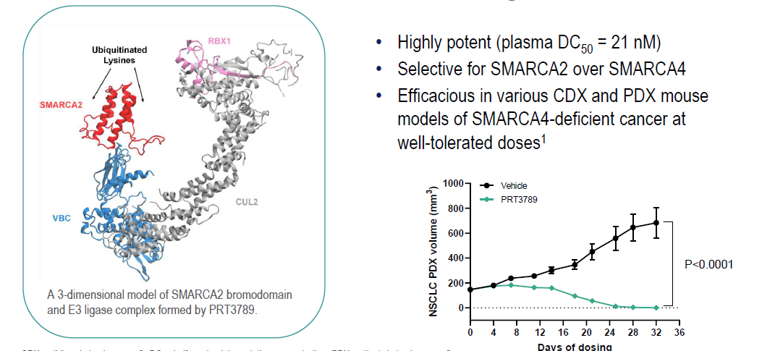
PRT3789, SMARCA2 degrader
Guo et al, ESMO 2024

Slide 24
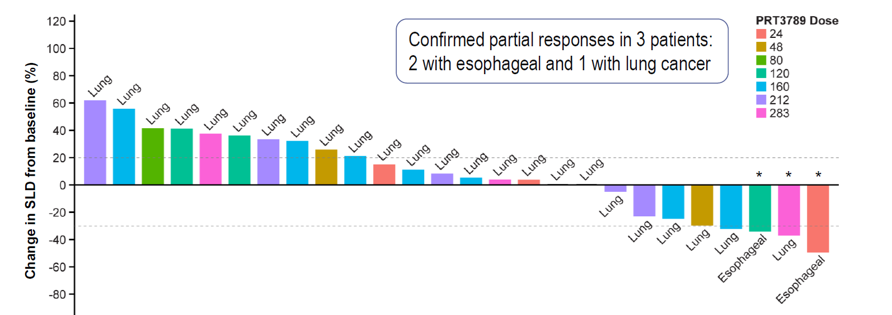

PRT3789, SMARCA2 degrader, in SMARCA4 altered cancers
Guo et al, ESMO 2024

Slide 25
Summary: Targeting SMARCA4 alterations
SMARCA4 alterations lead to loss of function of SMARCA4(BRG1) in ~8% of patients
Synthetic lethal approach with IV SMARCA2 degrader leads to some tumor shrinkage
Further refinement of biomarkers (LOF mutations only? IHC?) and further prospective trials with new drugs (oral?) will help to define whether this is targetable

Slide 26
Are TP53 mutations a target?
TP53 mutations in NSCLC tumors, Data from Genie 17.0 public, accessed at genie.cbioportal.org

Slide 27
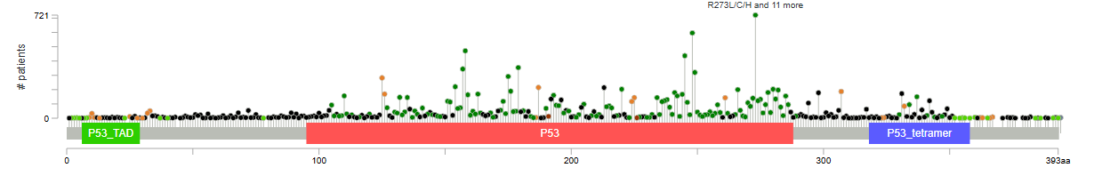
Of all these mutations that can inactivate P53, one has a drug that aims to “reactivate” P53
TP53 Y220C
Spectrum of TP53 mutations, Data from Genie 17.0 public, accessed at genie.cbioportal.org

Slide 28
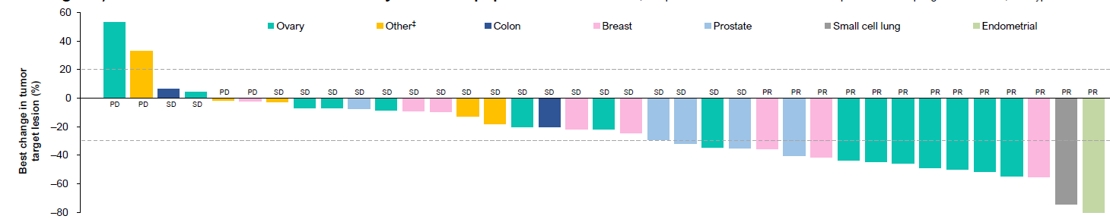
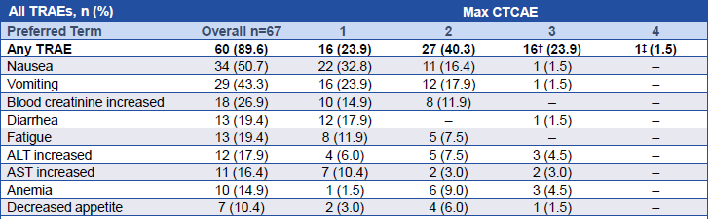
PC14586 in patients with advanced solid tumors harboring a TP53 Y220C mutation
Excluded patients with KRAS
Only included a single patient with small cell lung cancer
Schram et al, AACR 2023

Slide 29
Targeting TP53
A rare subset of TP53 mutations may be targetable (in absence of other driver oncogenes).
We await more data from patients with non-small cell and small cell lung cancer.

Slide 30
Summary
Not all pills that target cancer are TKIs!
Numerous mutations in tumor suppressor genes can lead to loss of function.
Some tumor suppressor genes can be targeted using “synthetic lethal” approaches
New targets with new drugs are in clinical trials!

